Slide 1
Challenge Your Hacking Skills
Ryan Coon
CYB-610
Professor Ian Standefer
April 30, 2025

Slide 2
Explain how you plan, organize, and perform penetration testing on your Metasploitable 2 VM.
These virtual machines (VMs) are intentionally vulnerable. Their purpose is exclusively educational, providing a controlled environment for penetration testing and security software evaluation. Properly secured VMs would render such exercises futile, thereby hindering the learning process. Therefore, these VMs' inherent vulnerabilities are integral to their pedagogical design.
After we installed this machine, we ran NMAP scan from our Kali machine to determine the IP addresses.
Having identified the IP addresses of the host and the target VM, we proceed with a penetration test. This test allows us to actively discover vulnerabilities and learn the techniques attackers use to compromise a system. By understanding these methods, we can effectively protect future systems from similar attacks.

Slide 3
Provide a brief summary of why a penetration test is valuable to an organization.
Penetration testing, also known as ethical hacking, serves as a crucial testing and quality control process. It rigorously evaluates a system's security posture, identifying vulnerabilities before they can be exploited by malicious actors. Professional penetration testers simulate real-world attacks, pinpointing weaknesses and reporting findings to stakeholders. This ensures that investments are protected and systems are ready to defend against threats. By identifying and rectifying vulnerabilities offline, penetration testing helps guarantee that the system is secure and capable of protecting digital assets upon launch.

Slide 4
Describe how you would handle failures in following procedures.
System failures frequently result from human error, encompassing several key issues: insufficient training (making employees the weakest link), excessive access privileges, weak or unchanged passwords, and the use of unauthorized, unsupported software from unofficial sources. The best defense is a strong security posture: robust training, strict access control, strong password policies with regular updates, and the use of reputable, updated software. A proactive approach includes treating security incidents as learning opportunities to foster continuous improvement.
To mitigate the failure points, success hinges on several key strategies. First, invest in comprehensive team training to minimize human error. Second, implement strict access controls, ensuring sensitive information is encrypted and accessible only to authorized personnel. Third, enforce robust password policies with regular expiration (e.g., every 90 days). Fourth, utilize reliable, supported security software. Fifth, maintain secure cloud-based data backups. Finally, establish a comprehensive incident response plan with 24/7 cyber first responders to address threats effectively. To ensure success, focus on these key factors: invest in comprehensive team training to reduce human error, implement strict access controls with encryption for sensitive data, enforce strong password policies with regular expiration (e.g., every 90 days), use reliable and supported security software, maintain secure cloud-based data backups, and have a comprehensive incident response plan with 24/7 cyber first responders. To ensure success, prioritize these strategies: invest in comprehensive team training to minimize human error, implement strict access controls, ensuring sensitive data is encrypted, enforce strong password policies with regular expiration (e.g., every 90 days), use reliable and supported security software, maintain secure cloud-based data backups, and establish a comprehensive incident response plan with 24/7 cyber first responders

Slide 5
Tools Used
NMAP
NIKTO
OWASP ZAP
NESSUS

Slide 6
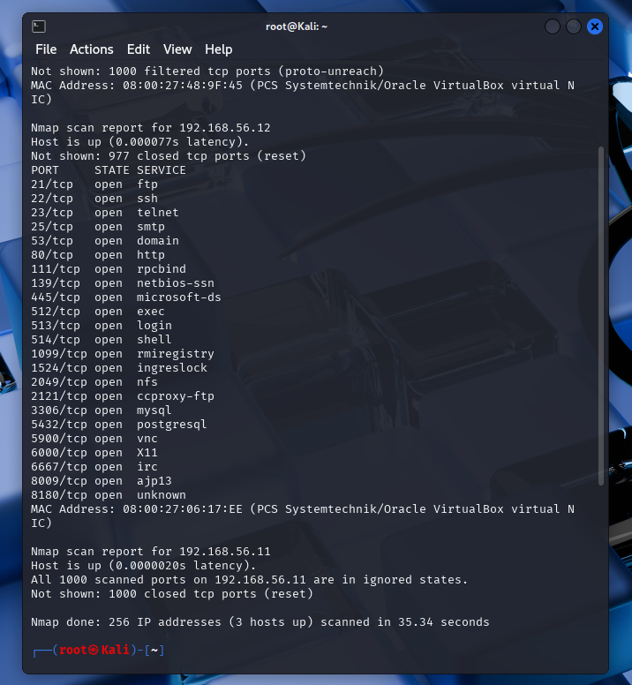
NMAP
I ran an NMAP scan to scan all of the ip addresses on the last octet on the host machine.
The scan revealed that the Metasploitable 2 box has ip 192.168.56.12

Slide 7
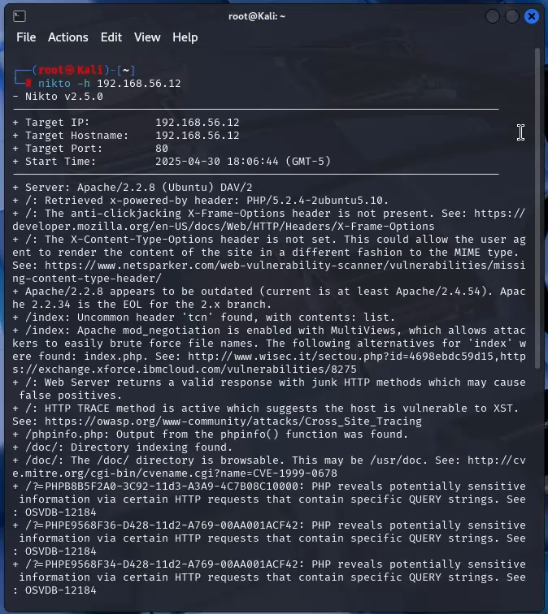
Nikto
I then ran a Nikto scan from root by running the command nikto –h 192.168.56.12
Vulnerabilities found:
The Anti-clickjacking, x-frame-options, is not present.
Apache/2.2.8
OSVDB-877 http trace method is active.

Slide 8
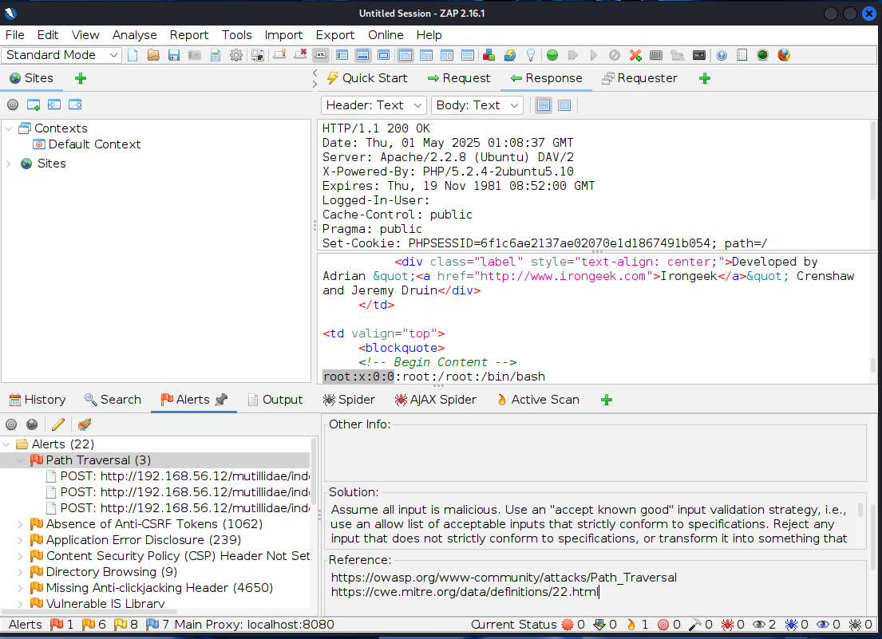
OWASP ZaP
Ran a zap scan to find vulnerabilities. Among the Apache and CVE-2007-5000, We can also clearly see a red alert on path traversal.
This is a web vulnerability where an attacker manipulates user input to access files or directories outside the intended web root directory.
Notes:
Assume all input is malicious. Use an "accept known good" input validation strategy, i.e., use an allow list of acceptable inputs that strictly conform to specifications. Reject any input that does not strictly conform to specifications, or transform it into something that does. Do not rely exclusively on looking for malicious or malformed inputs (i.e., do not rely on a deny list). However, deny lists can be useful for detecting potential attacks or determining which inputs are so malformed that they should be rejected outright.
When performing input validation, consider all potentially relevant properties, including length, type of input, the full range of acceptable values, missing or extra inputs, syntax, consistency across related fields, and conformance to business rules. As an example of business rule logic, "boat" may be syntactically valid because it only contains alphanumeric characters, but it is not valid if you are expecting colors such as "red" or "blue."
For filenames, use stringent allow lists that limit the character set to be used. If feasible, only allow a single "." character in the filename to avoid weaknesses, and exclude directory separators such as "/". Use an allow list of allowable file extensions.

Slide 9

Risk assessment and gap analysis
Vulnerability scans using Nikto and OWASP ZAP identified several high-risk issues. Nmap revealed open ports potentially vulnerable to exploitation. Nikto flagged outdated software and misconfigurations. OWASP ZAP detected common web application vulnerabilities, including cross-site scripting and path traversal. These findings align with current cybersecurity trends, where attackers frequently exploit common web vulnerabilities, often using phishing campaigns or malware deployment. A gap analysis indicated that while baseline security controls exist, critical areas like patch management require improvement.

Slide 10

Countermeasures and expected results
To address the identified vulnerabilities, I recommend a multi-pronged approach. First, implement a robust patch management system to ensure timely software updates, mitigating the risks highlighted by Nikto. Second, restrict access to open ports through strict access controls, limiting access to trusted IPs and authenticated users only. Third, deploy a Web Application Firewall (WAF) to filter and monitor HTTP requests, protecting against web-based attacks (e.g., XSS, SQL injection) identified by OWASP ZAP. Fourth, incorporate input validation and sanitization into secure coding practices to prevent vulnerabilities stemming from application input points.
These measures will significantly strengthen the organization's security posture, reducing the risk of successful exploitation, safeguarding sensitive data, and maintaining system integrity. This proactive approach will mitigate immediate risks and build a robust, long-term defense against evolving threats.

Slide 11
Strategies and system hardening for risk reduction
Mitigation Strategy and Risk Reduction
My strategy prioritizes addressing high-priority vulnerabilities through a comprehensive, layered security approach. This multi-layered defense integrates regular patch management, secure configurations, Web Application Firewall (WAF) protection, and robust access controls. This approach not only resolves existing vulnerabilities but also proactively strengthens our security posture, enabling adaptation to emerging cyber threats.
System hardening and risk mitigation
This strategy effectively reduces risk by addressing critical vulnerabilities, restricting unauthorized access, and minimizing exposure to potential attacks. By strengthening the system through these measures, exploitable weaknesses are significantly reduced, making it more difficult for attackers to compromise the network or disrupt operations. The result is a robust and secure infrastructure that aligns with cybersecurity best practices and enhances overall resilience.

Slide 12
Implemented changes
Justification for Implemented Changes
The implemented changes – disabling unnecessary services, applying software updates, and configuring additional firewall rules – were selected for their cost-effectiveness, simplicity, and high impact. These resource-efficient measures are quick to implement and directly address the high-risk vulnerabilities identified in the scans. By focusing on critical areas like exposed services and outdated software, these changes significantly decrease the attack surface while maintaining operational continuity and enhancing the overall security posture.
Addressed Vulnerabilities
Disabling unnecessary services effectively mitigated risks associated with open ports, minimizing the potential for exploits targeting outdated protocols like FTP and Telnet. Applying software updates resolved known vulnerabilities in outdated packages, reinforcing defenses against exploitation. Additionally, implementing firewall rules restricted access to critical services like SSH, reducing unauthorized access opportunities and enhancing overall access control.

Slide 13
Vulnerabilities impacted by the change
To identify vulnerabilities, I would start with automated scans using tools like Nessus and Nikto to detect network and server vulnerabilities, focusing on easily exploitable configurations such as open ports and outdated software. For web applications, I would utilize OWASP ZAP for both automated and manual testing to identify weaknesses in web forms, cookies, and user inputs by analyzing and modifying HTTP requests. Finally, consolidating and mapping these vulnerabilities across systems would provide a comprehensive overview of the security posture, emphasizing critical areas for remediation.

Slide 14
Expected vs actual results
We expected to see fewer vulnerabilities, restricted access to open ports, and fewer outdated software packages. We largely achieved these goals, as disabling unnecessary services and updating software successfully reduced the number of exploitable entry points. However, because Metasploitable 2 is intentionally designed to be vulnerable, some vulnerabilities remained even after updates. This highlights the need for extra security measures in such environments.

Slide 15
Lessons learned
Securing the Metasploitable 2 VM emphasized the critical role of layered defenses. Certain vulnerabilities, particularly in legacy systems, can persist despite implementing standard patching and access controls, highlighting the necessity for robust, multi-faceted security measures. This process also underscored the importance of balancing immediate, high-impact remediation efforts with comprehensive, long-term strategies to mitigate underlying risks. Ultimately, the experience reinforced the value of consistent vulnerability management and adaptive security practices to stay ahead of evolving threats.

Slide 16
References:
Agarwal, K. (2018, January 25). 10 Ways to Improve Data Security. Lepide Blog: A Guide to IT Security, Compliance and IT Operations.
https://www.lepide.com/blog/ten-ways-to-improve-data-security/
Anderson, C. (2022, November 13). How Do You Validate Written Procedures? Bizmanualz.
https://www.bizmanualz.com/writing-policies-andprocedures/how-do-you-know-your-procedures-work.html
Fruhlinger, J., Sharma, A., & Breeden, J. (2023, August 15). 15 top open-source intelligence tools. CSO Online.
https://www.csoonline.com/article/567859/what-is-osint-top-open-source-intelligence-tools.html
Gill, R. (2023, February 23). What is OSINT (Open-Source Intelligence?) | SANS Institute.
Www.sans.org. https://www.sans.org/blog/what-is-open-source-intelligence/
Integrify. (2025). Top Workflow Automation Platform for Streamlined Operations. Integrify.com.
https://www.integrify.com/business-processmodeling/
Penno, S. (2024, February 12). 8 Steps To Making Systems More Secure. Allied Telesis.
https://www.alliedtelesis.com/us/en/blog/8-steps-making-systems-more-secure

